Slide 1



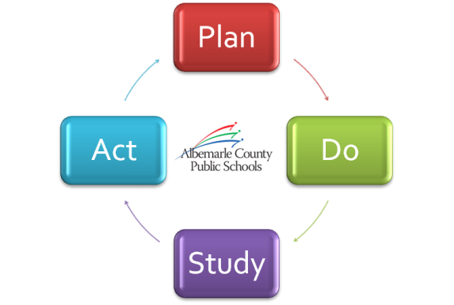
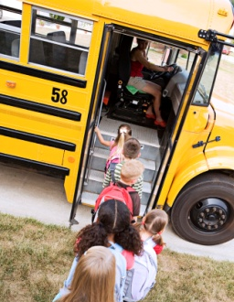

A Look at Our Strategic Performance
2012-13 Q3 Progress Summary
May 9, 2013

Slide 2
Goal 1
Lifelong Learning
Learning Spaces
Goal 2
Performance Tasks
Goal 3
Workforce Engagement
Goal 4
Goal 5
Review of Vision, Mission, Goals
Communications
Program Evaluation and Valuation
Academic Excellence Scorecard
Continuous Improvement

Slide 3
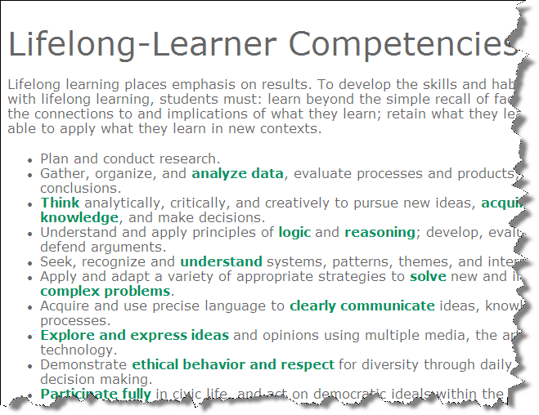
Goal 1
Lifelong Learning
Spring Survey
8390
Elementary School, Middle School and
High School Students

Slide 4
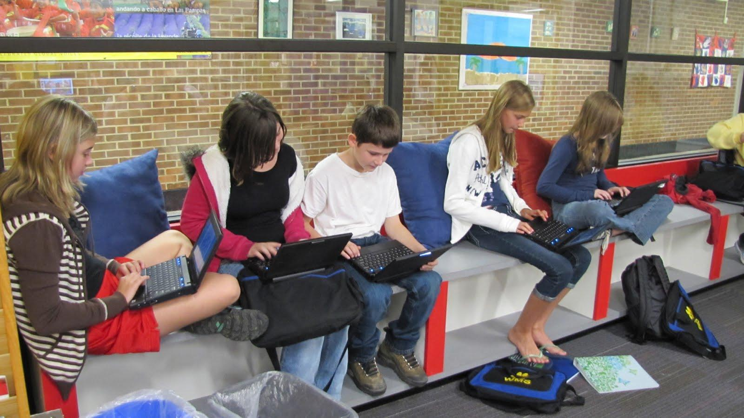
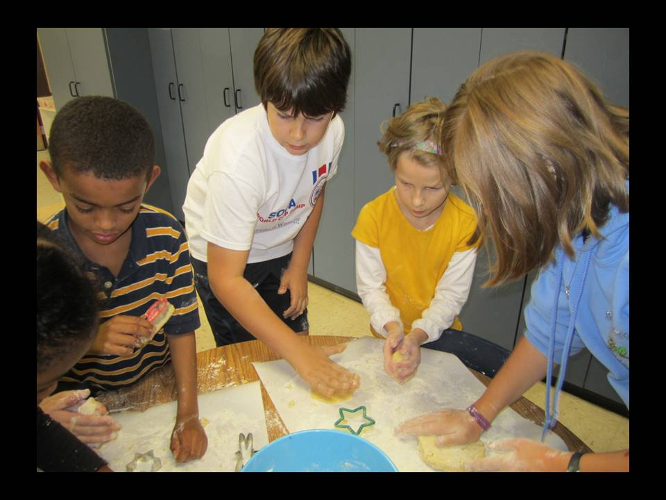
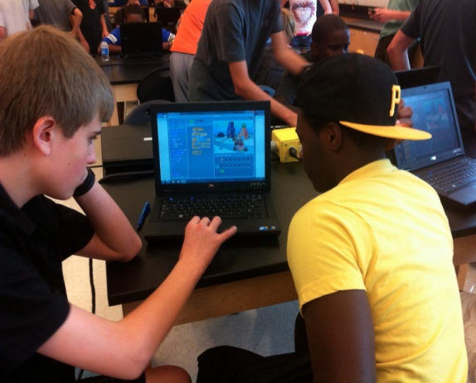

Goal 1
Learning Spaces
Maker Space
Interactive Technology

Slide 5
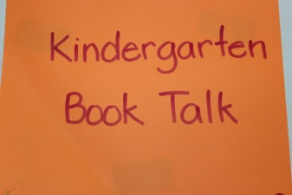
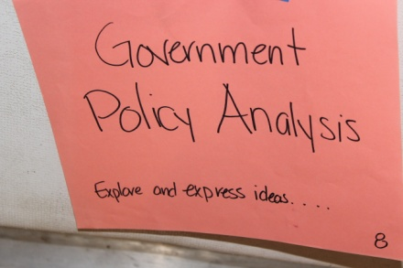
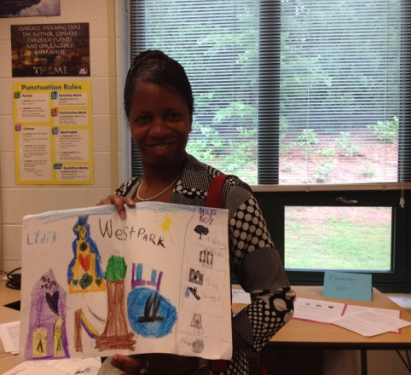
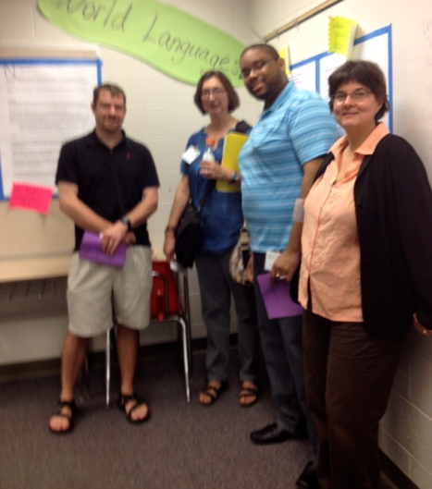
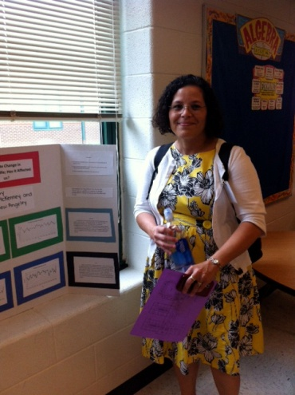
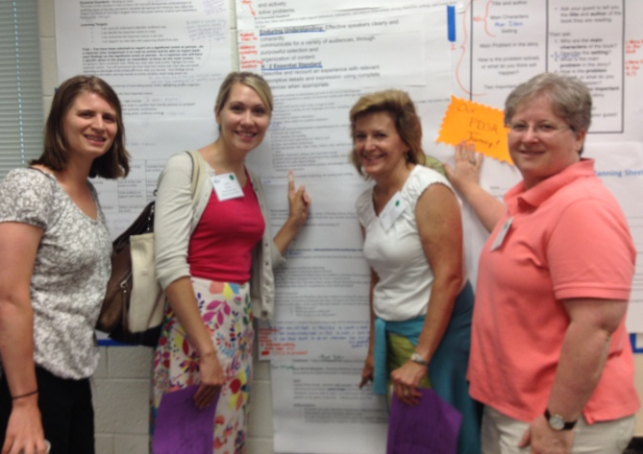
Goal 2
Performance Tasks
Next Step – Analysis at CAI 2013
Notes:
As students throughout the Division complete performance tasks, results are being collected and organized for analysis. The next phase of this work will take place in CAI 2013.

Slide 6
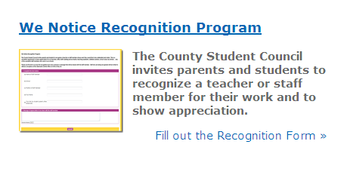
Goal 3
Employee Recognition
Collaboration between County Student Council and Leadership Team
Recognition Ceremony
on May 23rd

Slide 7

Goal 4
Strategic Plan Review
Strategic Plan Review
Update on progress presented to School Board on April 25th
Recommendations and supporting data will be presented at School Board Retreat for Board direction

Slide 8
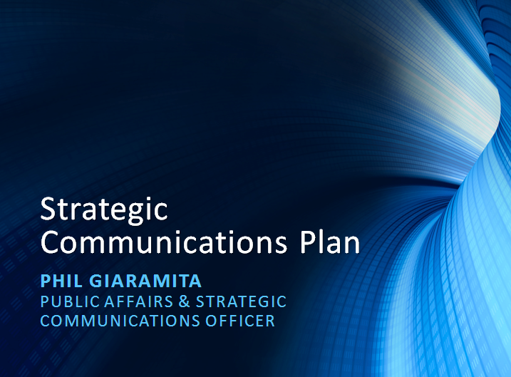
Goal 4
Strategic Communications Plan
Strategic Communications Plan
Presented at April 25th Work Session
Follow-up at School Board Retreat

Slide 9


Goal 4
Academic Excellence Scorecard

Slide 10
Goal 5
Valuation
Community Survey: “Please review each topic and indicate your level of support for ACPS continuing to explore each opportunity in order to prepare for our students' future needs.”
Teacher Professional Development tops the list of initiatives that participants supported.
Meeting with University of Virginia doctoral student to explore additional options later this month.

Slide 11
Q & A

